Slide 2
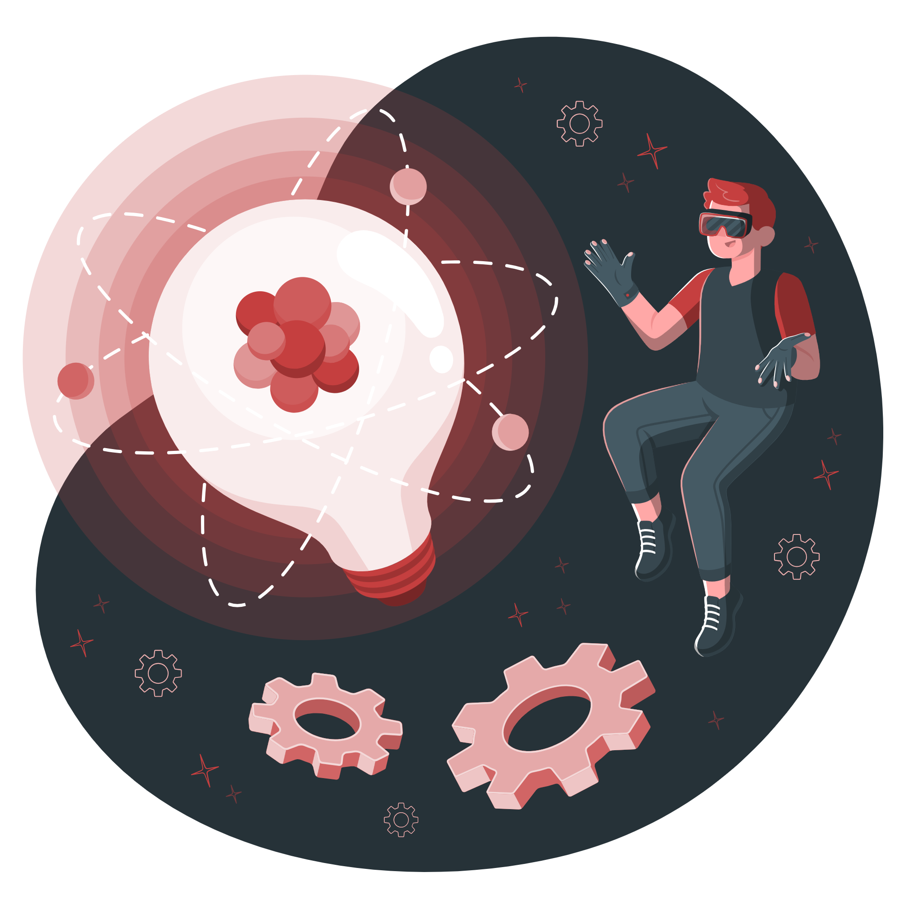
The Team – Code Breaker
Theme – Health
Abubakr Valentine - valentinemay445@gmail.com
Muneeb lewis - mrlewis0182@gmail.com
Tristan Hendricks - tristanhendricks19@gmail.com
Wayden Harker - waydenryan26@gmail.com

Slide 3
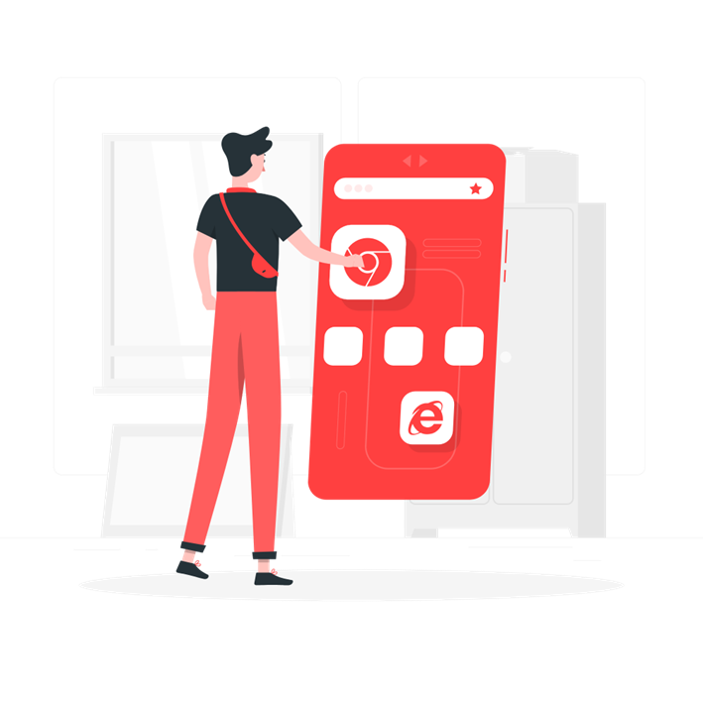
The Problem
Domain: Foodborne Illnesses in South Africa
Broader Context:
In South Africa, 1 out of 4 people get sick from bad food every year—like when meat goes bad or veggies go moldy. In poor/ undeveloped areas, many street vendors can’t keep food cold or clean, and most haven’t learned how to handle food safely. Dirty water also spreads diseases, making things worse. For people with weak immune systems (like those with HIV), bad food can be deadly—they’re 5x more likely to end up in the hospital. In 2017, a bad meat outbreak killed over 200 people. Our solution fixes this by helping vendors keep food fresh, teaching simple safety tips, and making sure everyone has fair access to clean tools and knowledge.

Slide 4
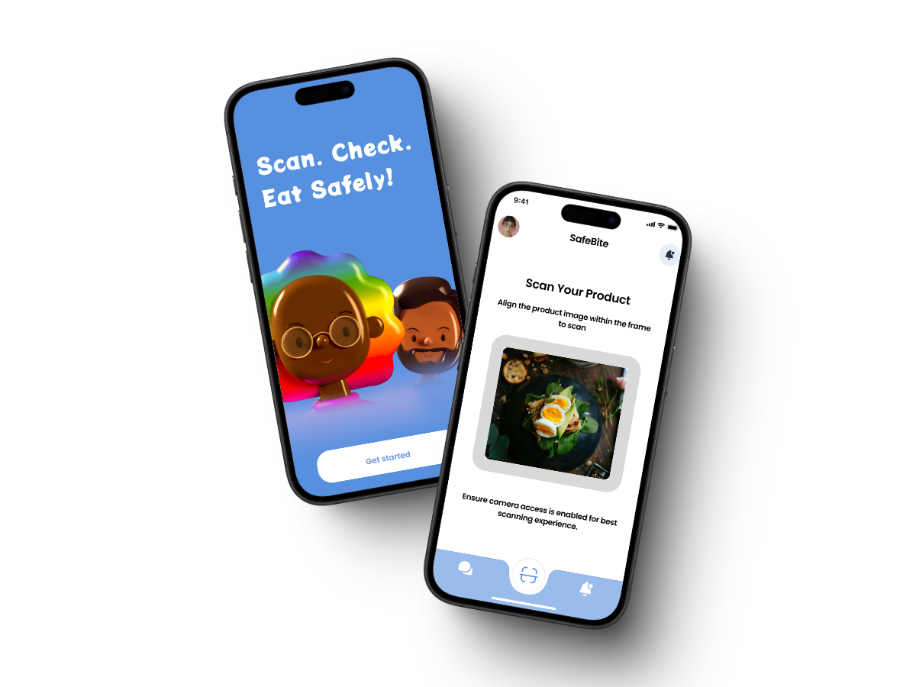
AI Concept
Solution: SafeBite ZA – A hyper-localized AI platform designed to combat food contamination and foodborne illnesses in Cape Town’s communities.
Real-Time Contamination Detection: Use smartphone cameras and low-cost IoT sensors to scan food for contaminants (e.g., _Listeria_ in processed meats, _E. coli_ in water). Example: Scanning "biltong“ (dried meat) detects mold or bacterial growth via AI image analysis and odor simulation (trained on SA-specific food databases).
Community Reporting & Crowdsourcing: Users report unsafe street food vendors or contaminated products (e.g., expired _"samp and beans"_ sold in spaza shops). - Real-time heatmaps alert Cape Town Health Department to high-risk areas like Khayelitsha or Mitchells Plain.
Multilingual Education: AI-generated food safety tips in isiXhosa, Afrikaans, and English (e.g., “How to store _pap_ safely”). - Gamified quizzes: “Earn points for proper handwashing techniques!”

Slide 5
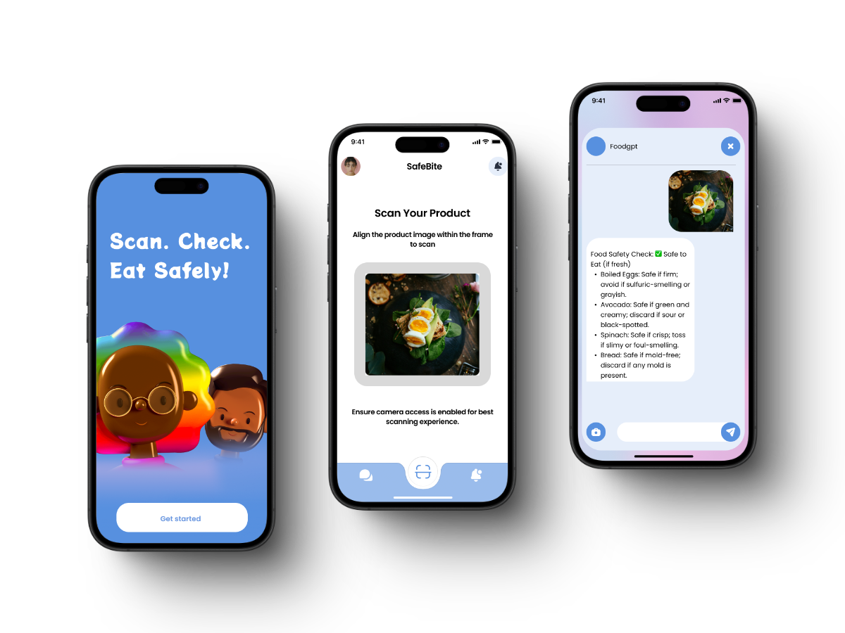
UI/UX Design

Slide 6
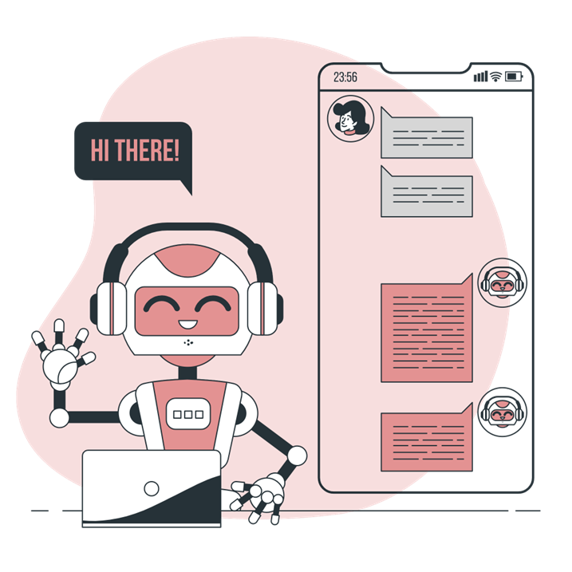
Use of Artificial Intelligence
Computer Vision:
Azure Custom Vision trained on 50,000+ images of South African foods (e.g., boerewors, amasi) to detect spoilage.
Predictive Analytics:
Azure Machine Learning forecasts contamination risks using local data (e.g., water quality reports from Cape Town’s informal settlements).
Azure AI Services that can be used out of the box:
Azure AI search: to provide a basic description of how selected foods are supposed to look, smell, taste and feel.
Azure AI Translator: to translator the app’s dialogues, menus and text into languages other than English.

Slide 7
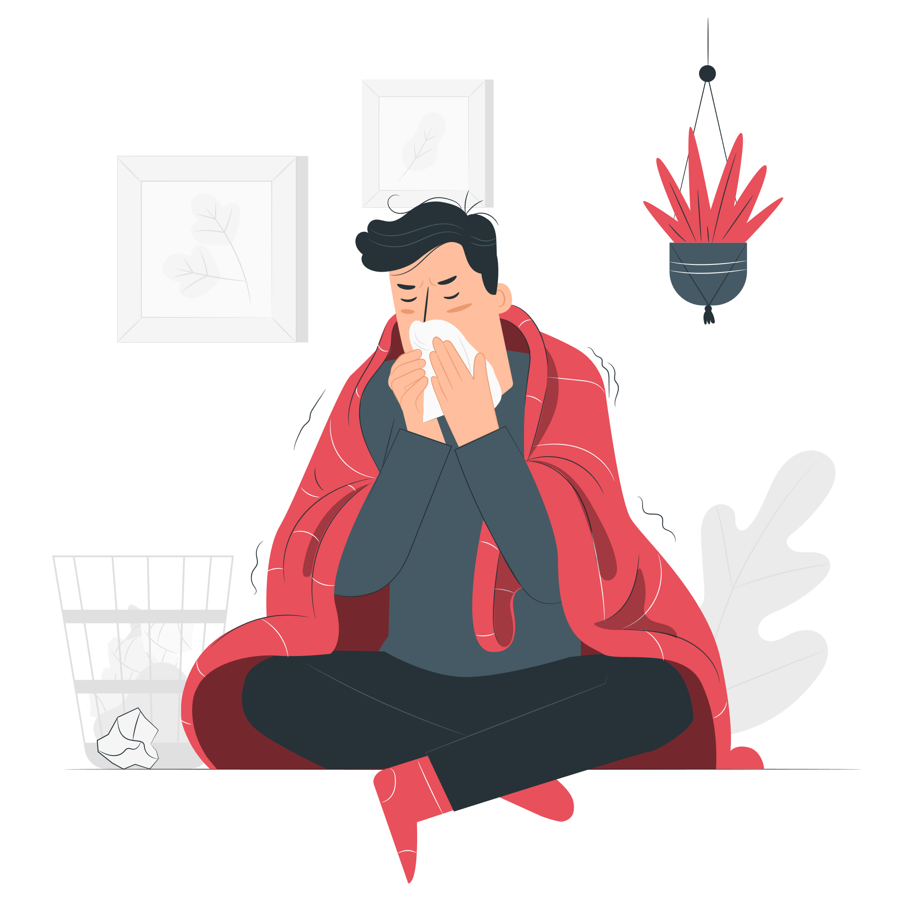
Impact
What impact would your solution have? This software would have a significant impact on South Africa by promoting healthier eating habits through real-time food freshness analysis. By helping users identify fresh and nutritious food options, it encourages better dietary choices. Additionally, the app fosters good food hygiene practices by educating users on recognizing spoilt produce and proper food storage methods.
If the stated problem is solved, how would it improve the lives of the affected users? By enabling users to report sellers dealing in spoiled food, the app helps prevent foodborne illnesses, ultimately reducing healthcare burdens. Its integration with local supermarkets ensures access to fresh produce, making it easier for users to find safe, high-quality food. This fosters a culture of food safety and wellness, benefiting individuals and communities across the country.

Slide 8
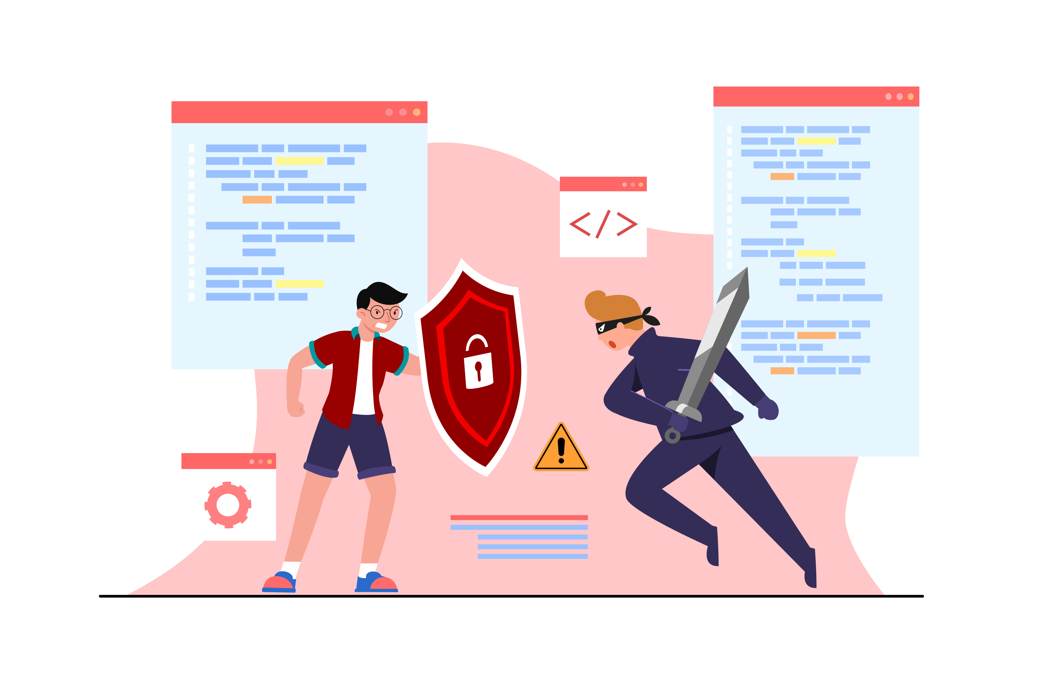
Ethics
Bias Mitigation: The dataset includes foods from all SA cultures (e.g., morogo, bobotie).
Transparency: Explainable AI dashboards in partnership with South African Bureau of Standards (SABS).
Legal compliance: Adhere to South Africa’s data protection laws for user consent and data handling
Human Oversight: It's crucial to have human eyes on the process.

Slide 9

Cybersecurity (Security and Privacy)
Privacy: Federated learning ensures data from townships stays on-device. Compliant with South Africa’s POPIA (Protection of Personal Information Act).
Metadata Scrubbing: Remove any hidden info in the photos, like GPS coordinates or timestamps, that could give away someone's location.
User Consent: Be upfront with users about how their data will be used and get their permission. Give them control over their data, so they can opt out if they want.
AI-Powered Threat Detection: AI can be used to detect and respond to potential security threats in real-time.

